Slide 1
HOME AUTOMATION
Student 1 (202IT132 - DHIVYAAN S)
Student 2 (202IT253 - THIANESH G)
Student 3 (202IT256 - VENGATESH HARI PRABU J)
Student 4 (202IT181 – NITHESH KUMAR S)

Slide 2
Abstract
Home automation is a topic which gaining popularity day by day, because of large advantages. One can achieve home automation by simply connecting home appliance electrical devices to the internet or cloud storage. the reason for this surge demand of network enabled home automation is reaching the zenith in recent days for its simplicity and comparable affordability. Platforms based on cloud computing help to connect to the things surroundings everyone so that one can find it easy to access anything and everything at any time and place in a user friendly manner using custom defined portals. Hence, cloud act as a front end to access IOT. Here we are assuming a system which can control devices through wireless based network or cloud based approach. In project we use IOT based home automation system which goal is to develop a home automation system that gives the user complete control over all remotely controllable aspects of his or her home. The automation system will have ability to be controlled from a central host PC, the internet, and also remotely accessed via a packet PC with a windows mobile based application.

Slide 3
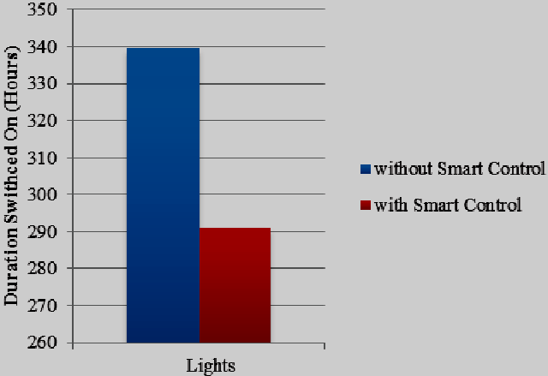
Problem Statement Addressed
Electricity is a basic need and can’t be limited, but the wastage can be avoided to some extent.
Wastage of electricity has become a routine in our daily life.
To overcome this problem we are designing the room using automation.

Slide 4
Existing Solutions
Home automation, though, is much less exceptional when it goes wrong. And, unfortunately, due to things like poorly integrated sub systems, inadequate functionality, and installation delays, home automation problems can arise. For example,
Heating unit not responding? Security cameras not connecting? Entertainment units dropping out? The issue could be that your sub systems are not integrating as they should.
This is a problem that can affect all systems, from a simple plugin device to a centrally controlled heating system. It frequently occurs when home owners or non-specialist tradespeople install smart devices themselves. The fault is caused by smart devices not communicating properly.
A problem such as this requires professional expertise as it can have a range of causes. It could be that your smart devices are incompatible with one another. Or it could be a simple software glitch.
If you're experiencing home automation problems involving sub systems not integrating, we recommend getting in touch. Our specialists can track down the root cause of the issue and help you to resolve it.

Slide 5
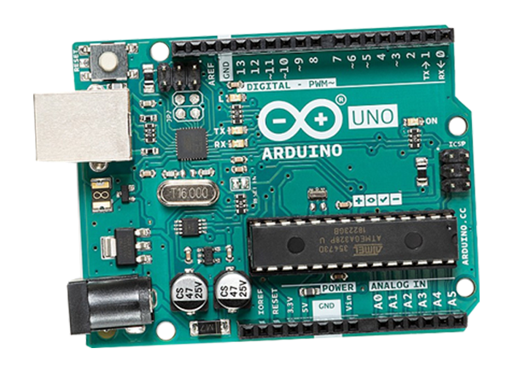
Proposed Solution to the Problem Addressed
Room Automation is a microcontroller based project.
The main advantage of this project is energy conservation.
This can be used in schools , colleges, trial rooms and other public places.
We can use this in our home appliances, because we forgot to off the fans and lights often.
By using this we can conserve electricity in our home.

Slide 6
Project Work Plan
When a person tries to enter the room, sensor 1 detects the person first and then sensor 2 .
This action will indicate the microcontroller that the person entering the room.
Then, the microcontroller will turn on the light.
Likewise, when the person tries to leave the room, sensor 2 detects the person first and then sensor 1.
This will make the microcontroller to understand the person trying to leave the room.

Slide 7
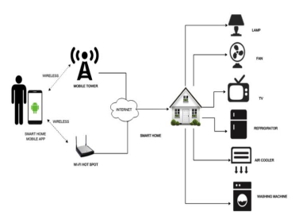
Block Diagram and/or Circuit Diagram

Slide 8
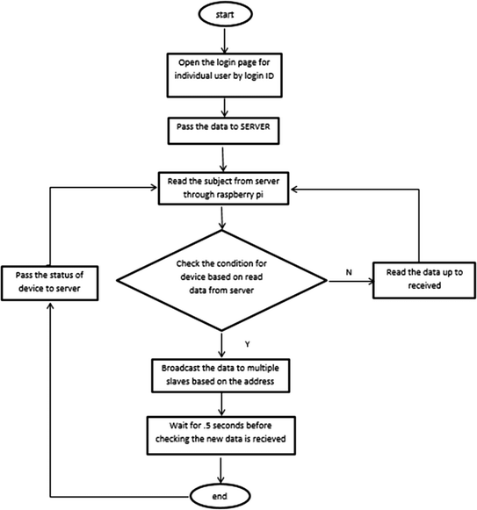
Flow Chart

Slide 9
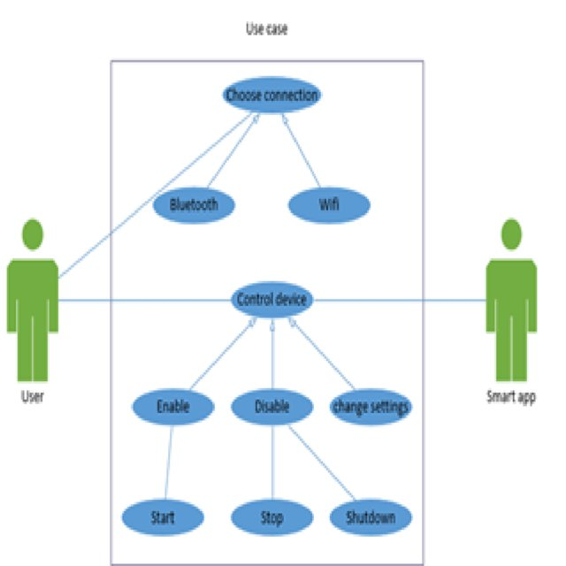
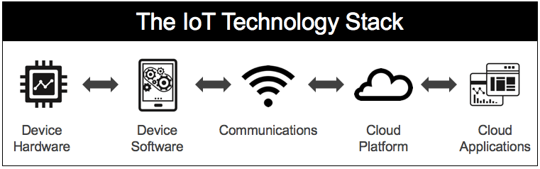
Technology stack & use case

Slide 10
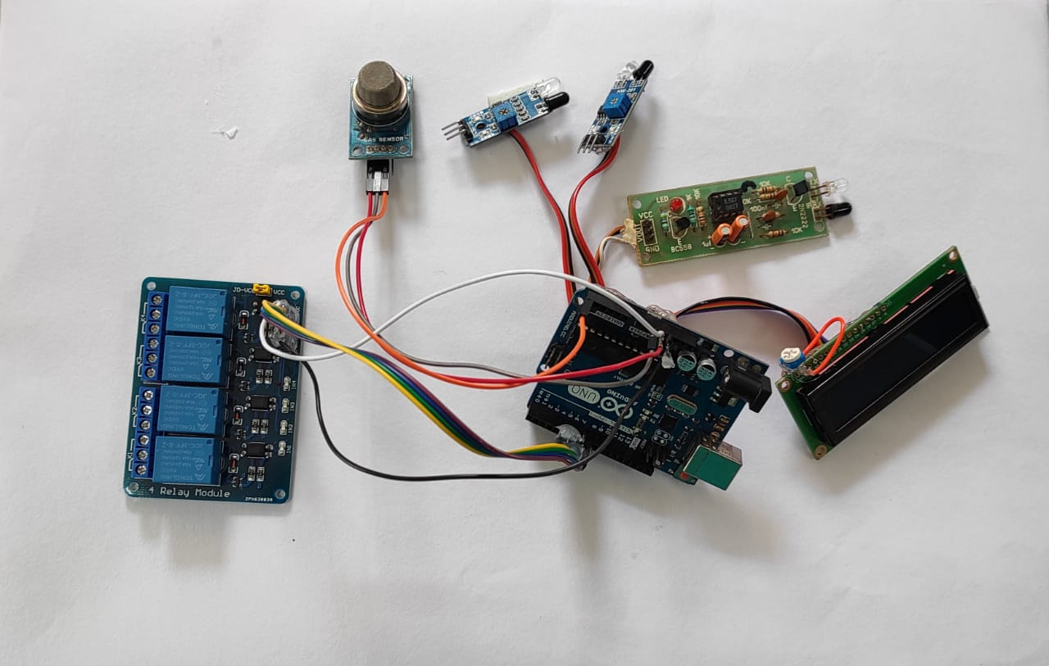
Prototype & Sample Output

Slide 11
Analysis of Results & Discussions
The Pros
1. Energy Savings
2. Convenience
3. Security
The Cons
1. Installation
2. Complex Technology
3. System Compatibility
4. Cost

Slide 12
References
https://integratedtechnologiesaustralia.com.au/resource-centre
https://www.researchgate.net/publication

